Slide 1

JC2001 Introduction to Software Engineering
Lecture 4: Project planning
Dr Xiao Li xiao.li@abdn.ac.uk (BSc Artificial Intelligence)
Dr Huang Yongchao yongchao.huang@abdn.ac.uk (BSc Business Management and Information Systems)
Dr Edward Chuah thuan.chuah@abdn.ac.uk (BSc Computing Science)
Notes:
…
This course is very important, especially if you want to work in the software development industry and IT companies, for example, Tiktok, Baidu, Google, Amazon, and so on.
In this course, we will NOT introduce any programming language. However, we will introduce the technology that how to architect your software and manage your software development process, human resource, and risks.
So, this course will roughly let you know how an IT company works, that is, how to develop software by a team.
Or, if you want to establish your own IT company, we will let you know how to manage your staff and your projects.

Slide 2
Outline
Project planning (Chapter 23)
Reference: Ian Sommerville, Software Engineering, 10th edition, Pearson, 2015.

Slide 3
Definition of project planning
Project planning is one of the most important jobs of a software PM. They break down the work into parts and assign them to project team members. The project plan, which is created at the start of a project and updated as the project progresses, is used to show how the work will be done and to assess progress on the project.
Project planning takes place at three stages in a project life cycle:
At the proposal stage, when you are bidding for a contract to develop or provide a software system.
During the project startup stage, when you have to plan who will work on the project, how the project will be broken down into increments, how resources will be allocated, etc.
Periodically throughout the project.

Slide 4
Costing a software project
There are three main parameters when computing the costs of a software project:
Effort cost. These are the costs of paying software engineers and managers.
Hardware and software cost. These are the costs of paying for hardware and software.
Travel and training costs.
For most projects, the biggest cost is the effort cost. This effort cost is usually estimated as the total number of in-person months that is likely required for completing the work of a project.
Travel and training costs are usually a small fraction of the effort cost.

Slide 5
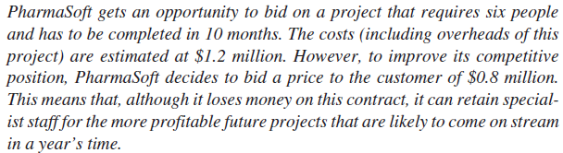
Costing a software project
This is an example of an approach to software pricing called ``pricing to win’’.
It means that a company has some idea of the price that the customer expects to pay and makes a bid for the contract based on the customer’s expected price.
This approach to pricing may seem unethical and unbusinesslike, but it does have advantages for both the customer and the system provider.

Slide 6
Mock quiz
You are reviewing 2 bids for building a new procurement system for your company. You estimate that the project will cost between $1 million to $1.5 million. Bid 1 and bid 2 estimated that the procurement system would cost $1.8 million and $1.4 million respectively. Bid 1 proposed a bespoke ``intelligent AI based’’ procurement system. Bid 2 proposed a commercial-off-the-shelf (COTS) procurement system. Which bid would you choose? Discuss your answer.
A bespoke product is a software solution built for a client’s specific requirements. Bespoke software is created just for you and will satisfy all your company’s requirements.
A COTS product is a hardware and/or software product that is commercially ready-made and available for sale, release or license to the general public.

Slide 7
Project plan
A project plan normally includes the following:
Introduction.
Briefly describes the objectives of the project.
Project organisation.
Describes the way in which the development team is organised, the people involved, and their roles in the team.
Risk analysis.
Describes possible project risks, the likelihood of these risks arising, and the risk reduction strategies that are proposed.
Hardware and software resource requirements.
Specifies the hardware and software support required to carry out the development.

Slide 8
Project plan
A project plan normally includes the following (cont’d):
Work breakdown:
Sets out the breakdown of the project into activities and identifies the inputs to and the outputs from each project activity.
Project schedule:
Shows the dependencies between activities, the estimated time required to each each milestone, and the allocation of people to activities.
Monitoring and reporting mechanisms:
Defines the management reports that should be produced, when these should be produced, and the project monitoring mechanisms to be used.

Slide 9
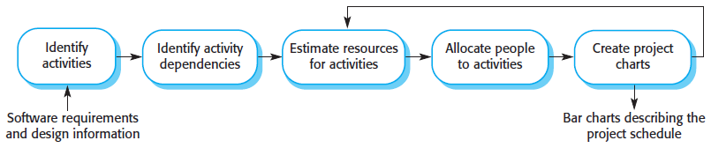
Project scheduling
Project scheduling is the process of deciding how the work in a project will be organised as separate tasks, and when and how these tasks will be executed.

Slide 10
Project scheduling
Both plan-based and agile processes need an initial project schedule, although less detail is included in an agile project plan. This initial schedule is used to plan how people will be allocated to projects and to check the progress of the project against its contractual commitments.
When estimating schedules, you must provide for some ``laxity’’ to allow for slippage in the various activities.
This is because people working on the project may fall ill or leave, hardware may fail, essential support software may be delivered late.
To address this issue, estimates of 30% to 50% may be added to the effort and time required for the project.

Slide 11
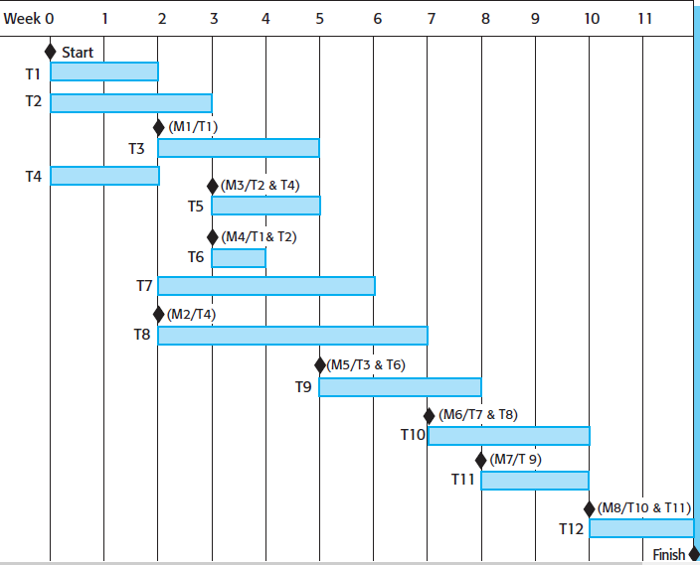
Schedule presentation (Activity bar chart)

Slide 12
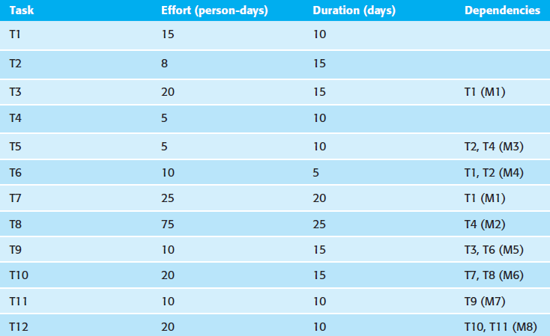
Schedule presentation (Tasks, durations and dependencies)

Slide 13
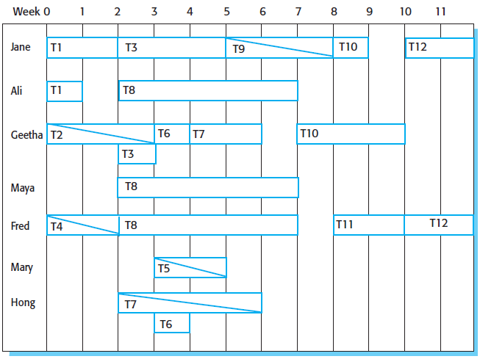
Schedule presentation (Staff allocation chart)

Slide 14
Mock quiz
What are the factors affecting project planning?
Uncertainty about the scope of the project.
High number of stakeholders with influence over the project.
Novelty of the project.
Significant change in the scope of the project during its implementation.
All of the above.
Reference: https://www.nitorinfotech.com/blog/factors-affecting-project-construction-and-planning/

Slide 15
Uncertainty about scope of project
3 methods for addressing project scope uncertainty.
Fixed schedule, fixed scope.
Fixed schedule, adjustable scope.
No schedule, unknown scope.
Fixed schedule, fixed scope:
When the project scope is fixed, schedule becomes uncertain.
Add 30% buffer time for repetitive tasks.
Fixed schedule, adjustable scope:
Suitable for use in agile development methodology. The only thing that can be controlled is the schedule.
Scope is adjusted as per the need.

Slide 16
Uncertainty about scope of project (cont’d)
No schedule, unknown scope:
Suitable for use in agile development methodology.
Uncertainties are greatest when the scope is unknown at the start.
Constraining work-in-progress is useful in such scenarios.

Slide 17
High number of stakeholders
Creates confusion with too many suggestions. You cannot agree to everyone’s wishes.
Ensure that every change suggested by a stakeholder must contribute to the success of the project.
Outline the goals and objectives, then prioritise the changes to deal with conflicts.
Know who is funding the project; they have the final say.

Slide 18
Novelty of the project
Occurs when new technological functions are introduced in the project.
Negatives:
Can cause scope changes.
Can cause platform changes.
Not familiar with the technology.
Positives:
Develop new capability for staff and company.
Increase organisation’s capabilities.
Employee training programs can help in reducing project novelty.

Slide 19
Significant project scope changes during implementation
Set up a structured approval process.
Set up a clear acceptance criteria.
Create a work breakdown structure.
Document every scope change.
Use project management software to manage the scope changes.

Slide 20

Agile planning
Agile methods of software development are iterative approaches where software is developed and delivered to customers in increments.
Unlike plan-driven approaches, the functionality of these increments is not planned in advance but is decided during the development.
Decision on what to include in an increment depends on progress and on the customer’s priorities.

Slide 21
Agile planning
Story identification:
The basis of the agile planning process is a set of user stories that cover all of the functionality to be included in the final system.
The SE team and the customer develop these user stories. The SE team ranks all the user stories based on the estimated amount of time for developing those stories. Larger stories are broken down into smaller stories.
Initial effort estimation:
Uses the idea of ``velocity points’’. ``Velocity points’’ are the number of effort points implemented by the team, per day.
These points can be estimated either from previous experience or by developing one or two stories to see how much time is required.

Slide 22
Agile planning
Release planning:
It involves selecting and refining the stories that will reflect the features to be implemented in a release of a system, and the order in which the stories should be implemented.
The customer has to be involved in this activity. A release date is chosen and the stories are examined to see if the effort estimate is consistent with that date. If no, stories are added or removed from the list.
Iteration planning:
It is the first stage in developing a deliverable system increment. Stories to be implemented during that iteration are chosen.
When the delivery date is reached, the development iteration is complete, even if all of the stories have not been implemented.

Slide 23
Agile planning
Task planning:
At the start of each development iteration, there is a task planning stage where the developers break down stories into development tasks.
A development task should typically take 4 to 16 hours. All of the tasks that must be completed to implement all of the stories in that iteration are listed.
Individual developers then sign up for the specific tasks that they will implement.
Each developer knows their individual velocity and so should not sign up for more tasks than they can implement in the time allocated.

Slide 24
Estimation techniques
There are two types of techniques for making estimates:
Experience-based techniques:
The estimate of future effort requirements is based on the manager’s experience of past projects and the application domain.
The manager makes an informed judgment of what the effort requirements are likely to be.
Algorithmic cost modeling:
In this approach, a formulaic approach is used to compute the project effort based on estimates of product attributes, such as size, process characteristics, and experience of staff involved.

Slide 25
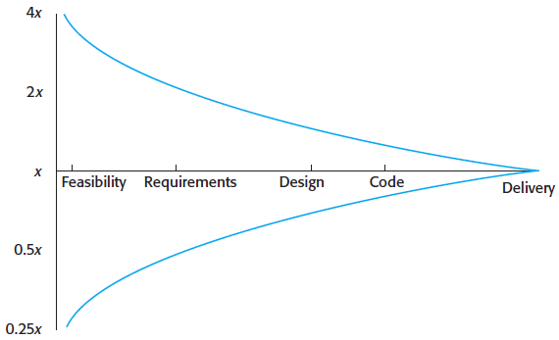
Estimation techniques
During development planning, estimates of effort required become more and more accurate as the project progresses.

Slide 26
Algorithmic cost modeling
Most algorithmic models for estimating effort in a software project are based on a simple formula:
Effort = A * Size^{B} * M, where
A: a constant factor, which depends on local organisational practices and the type of software that is developed.
Size: an assessment of the code size of the software or a functionality estimate expressed in function or application points.
B: represents the complexity of the software and usually lies between 1 and 1.5.
M: is a factor that takes into account process, product and development attributes, such as dependability requirements for the software and the experience of the development team. These attributes may increase or decrease the overall difficulty of developing the system.

Slide 27
Algorithmic cost modeling
The number of lines of source code (SLOC) in the delivered system is the fundamental size metric that is used in many algorithmic cost models.
To estimate the number of lines of code in a system, a combination of approaches can be used. They are as follows:
Compare the system to be developed with similar systems and use their code size as a basis for your estimate.
Estimate the number of function or application points in the system, and convert these to lines of code in the programming language used.
Rank the system components using judgment of their relative sizes, and use a known reference component to translate this ranking to code sizes.

Slide 28
Calculate application or function points
The number of application points in a program is derived from four simpler estimates:
The number of separate screens or web pages that are displayed.
The number of reports that are produced.
The number of modules in imperative programming languages (e.g., Java).
The number of lines of scripting language or database programming code.

Slide 29
Risk identification
Risk identification is concerned with identifying the risks that could pose a major threat to the software engineering process, the software being developed, or the development organization.
Risk identification may be a team process in which a team gets together to brainstorm possible risks. Alternatively, project managers may identify risks based on their experience of what went wrong on previous projects.

Slide 30
Risk identification
Six types of risk may be included in a risk checklist:
Estimation risks arise from the management estimates of the resources required to build the system.
Organizational risks arise from the organizational environment where the software is being developed.
People risks are associated with the people in the development team.
Requirements risks come from changes to the customer requirements and the process of managing the requirements change.
Technology risks come from the software or hardware technologies that are used to develop the system.
Tools risks come from the software tools and other support software used to develop the system.

Slide 31
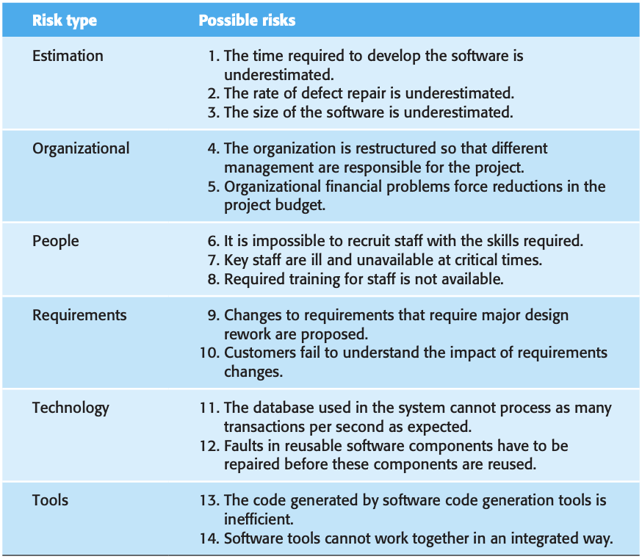

Slide 32
Risk analysis
In risk analysis, you have to consider each identified risk and make a judgment about the probability and seriousness of that risk.
You will need to rely on your judgment and experience of previous projects and the problems that arose in them.
It is not possible to make precise, numeric assessment of the probability and seriousness of each risk. Instead, each identified risk is assigned to one of a number of bands:
The risk might be assessed as insignificant, low, moderate, high, or very high.
The effect of the risk might be assessed as insignificant, tolerable, serious, or catastrophic.

Slide 33
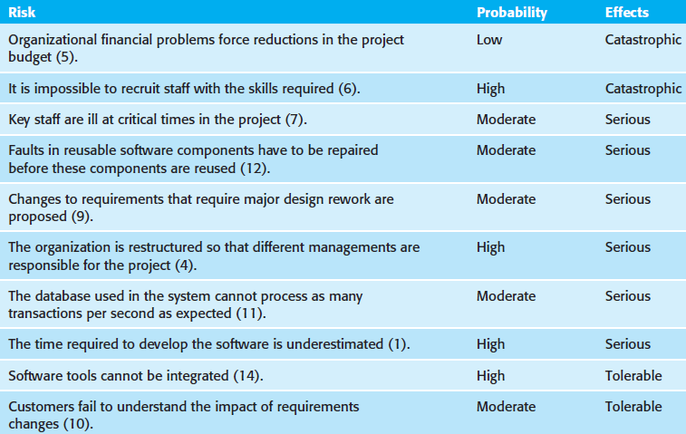
Risk analysis

Slide 34
Mock quiz
The 737 MAX cockpit is equipped with a sophisticated fly-by-wire system. A fly-by-wire system is a semi-automatic and typically computer-controlled system for controlling the flight of an aircraft. It collects data from multiple sensors on the aircraft, aggregates the data and adjusts the aircraft’s pitch, roll and yaw. One of the two air pressure sensors is blocked. Is this a low, medium or high risk scenario? Discuss your answer.
Reference: https://cacm.acm.org/magazines/2021/1/249448-boeings-737-max/abstract

Slide 35
Risk planning
Strategies for managing risks are divided into three categories:
Avoidance strategies:
Following these strategies means that the probability that the risk will arise is reduced.
Minimisation strategies:
Following these strategies means that the impact of the risk is reduced.
Contingency plans:
Following these strategies means that you are prepared for the worst and have a strategy in place to deal with it.

Slide 36
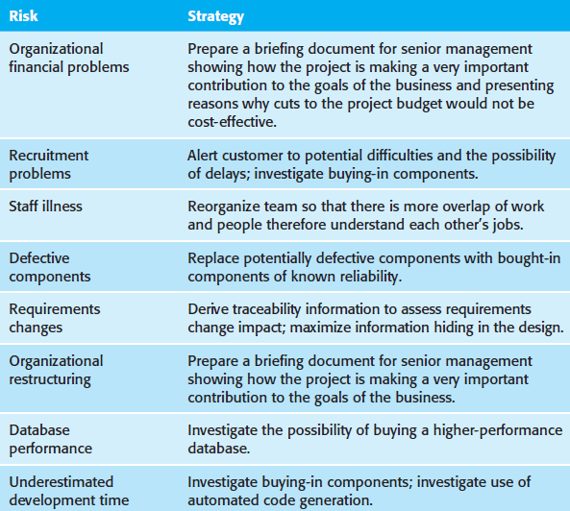
Risk planning

Slide 37
Summary
We described the project planning activities.
We showed how a project plan is developed.
We described the experienced-based and algorithmic modeling effort cost estimation techniques.
We discussed the importance of risk analysis and showed how risks are identified and ranked.

